Slide 1
BAN 502 – Module 6 Principal Components Analysis
Dr. Avinash Geda

Slide 2
Principal Components Analysis (PCA)
PCA is used to combine similar variables
Reduces number of variables in dataset (a problem with small data where # of columns could be > # of rows
Reduces multicollinearity

Slide 3
Principal Components Analysis (PCA)
Objective:
Explain as much variance in the data as possible with fewer variables
Before doing PCA:
Scale data
Deal with missingness
Avoid categorical data

Slide 4
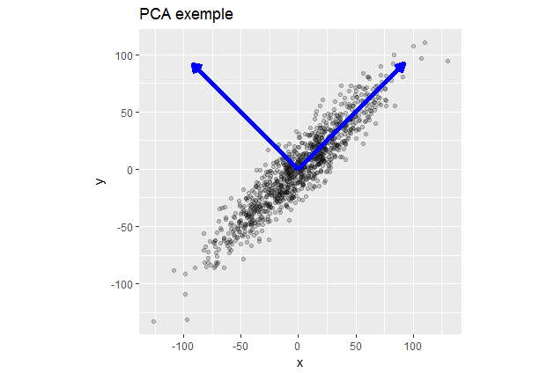
Principal Components Analysis in Software

